Slide 1
Multi Finger Touch tester Sop
Hongbing Wang 2020/10/30
V1.00

Slide 2
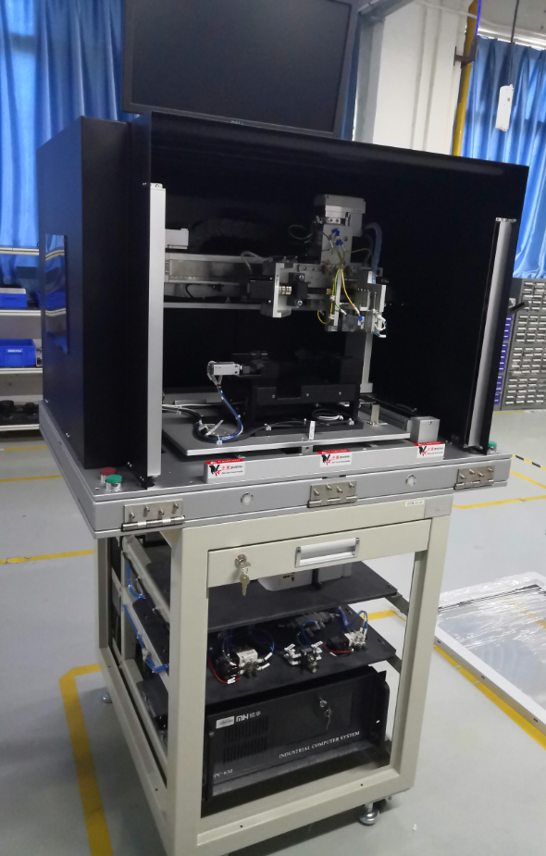
Overview
Monitor
Electric cylinder module
Cover
Fixture
DUT Loader in Testing Position
Safety grating
E-STOP
Button
Keyboard/Mouse Drawer
Base
PC

Slide 3
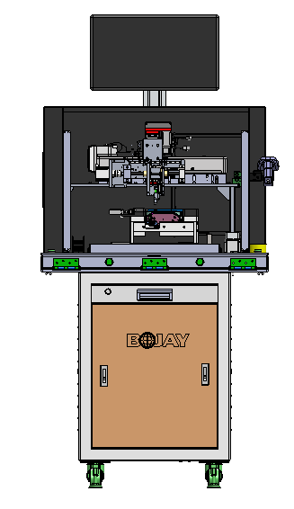
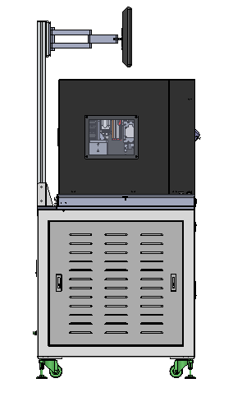
Station dimension
900mm
600mm
1800mm
1514mm
858mm
800mm
844mm

Slide 4
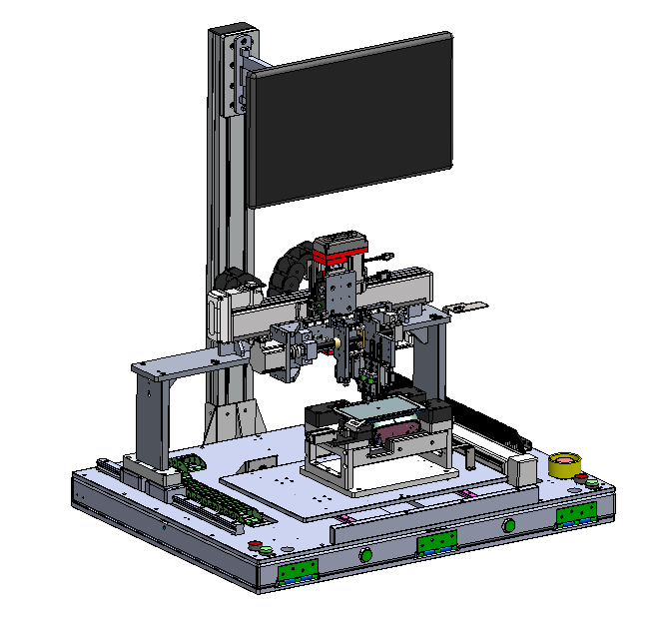
Fixture
Screen
Z direction movement range is 0 to 50 mm
The Z axis module
Mobile module,
Y direction
E71 Holder
Mobile module, X direction
Replaceable finger
Switch（Corresponding to E71 software）
E-stop
Guide
Three-color light
Switch

Slide 5
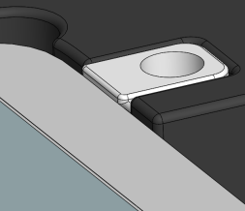
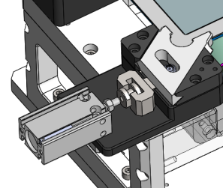
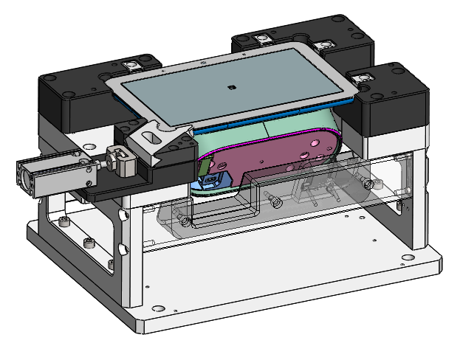
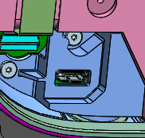
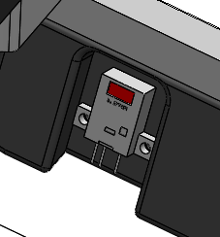
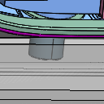
E71 DUT Holder
Positioning guard
Lateral pressure module
DUT
USB cable
In-position induction switch
Photoelectric switch module

Slide 6
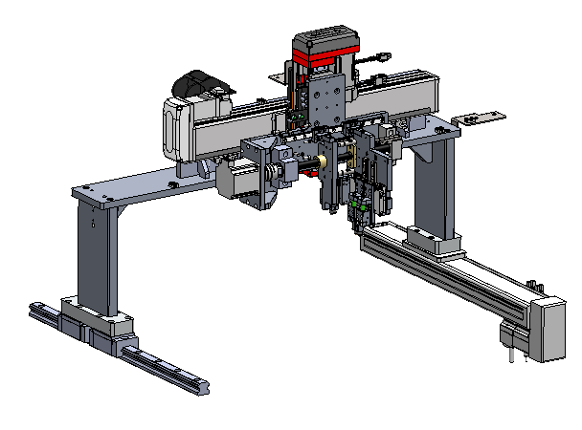
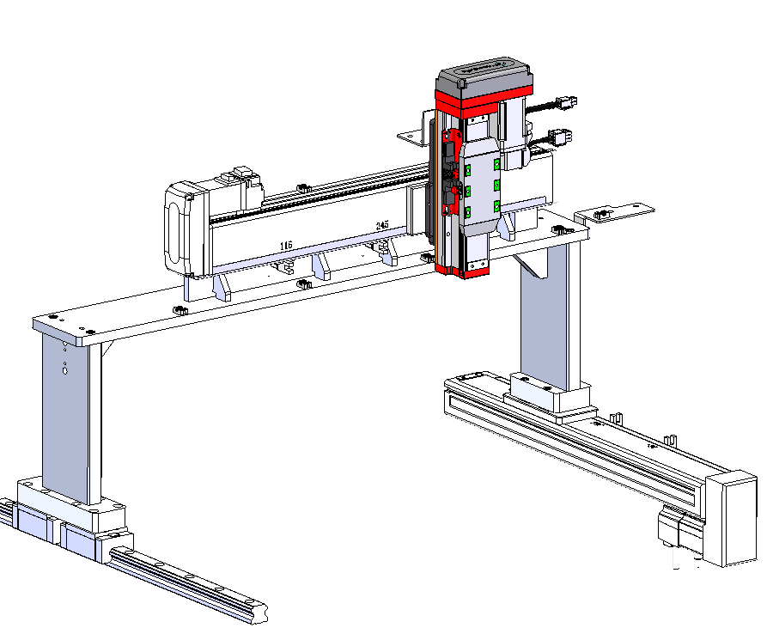
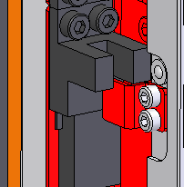
Action description
Z-Axis
Y-Axis
The origin position Sensor
R-Axis
X-Axis
1. Draw or tap the touch sensor of DUT via moving X/Y/Z axis;
2. Position sensor and switch mounted for each axis;
3. The origin Sensor cannot be adjusted。

Slide 7
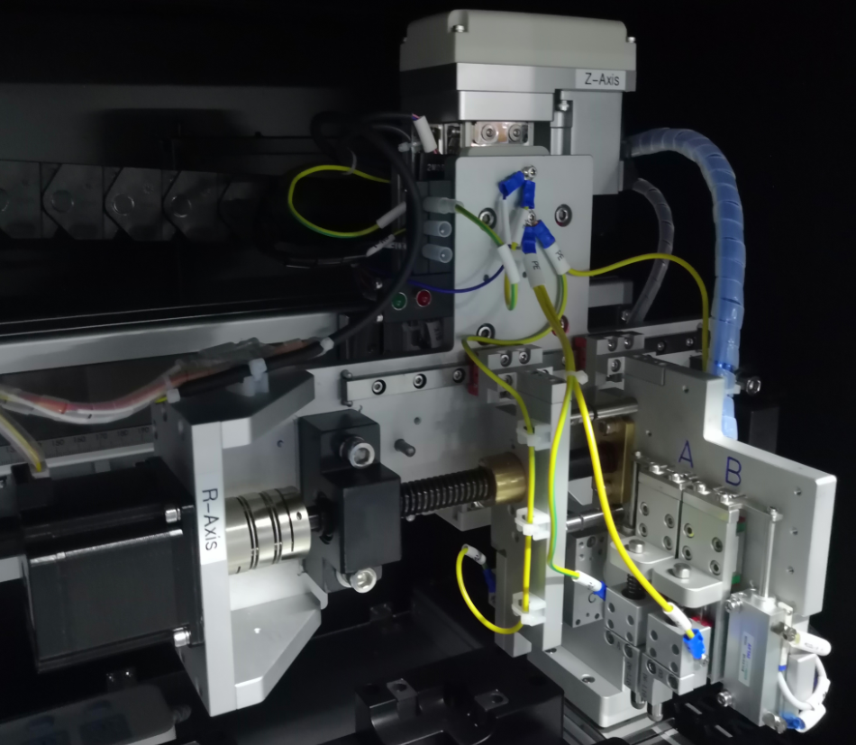
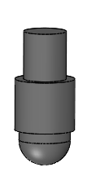
The Z axis module
Motor
Spring
Cylinder
Capacitance pen
/Copper head
The specifications of capacitor pens are as follows:
1. 6mm capacitance pen（Conductive cloth）/Copper head
2. 7mm capacitance pen（The silicone head）/Copper head
3. 9mm capacitance pen（The silicone head）/Copper head
4. 12mm Copper head

Slide 8
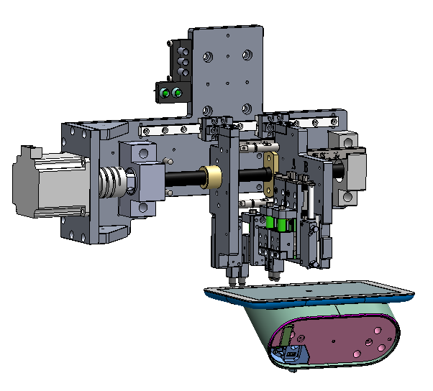
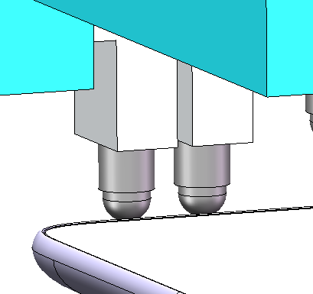
The X axis line
Cylinder up
X axis
Note（Increase the pen distance description）:
1、6mm fabric and copper/brass finger ；L min=10mm，L max=75mm
2、7mm rubber and copper/brass finger ；L min=12mm，L max=75mm
3、9mm rubber and copper/brass finger ；L min=13.5mm，L max=75mm
4、12mm copper/brass finger ；L min=15mm，L max=75mm
5、Theoretical screen stroke speed is 0-75mm/s
L

Slide 9
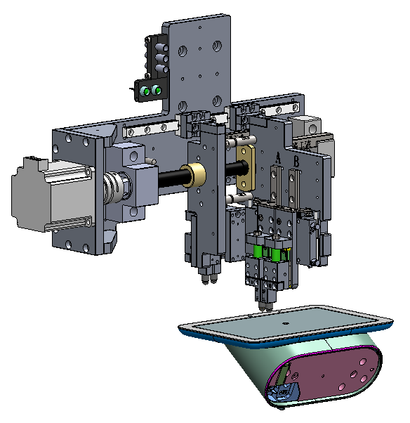
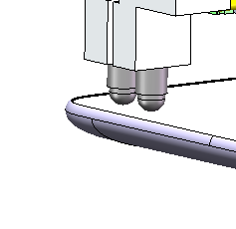
The Y axis line
Cylinder down
Y axis
L
Note（Increase the pen distance description）:
1、6mm fabric and copper/brass finger，L=10/15/20/30 . can’t be beyond 30mm due to interference
2、7mm rubber and copper/brass finger，L=12/ 15/20/30 . can’t be beyond 30mm due to interference
3、9mm rubber and copper/brass finger，L=15/20/30 . can’t be beyond 30mm due to interference
4、12mm copper/brass finger only，L=15/20 . can’t be beyond 20mm due to interference
5、Theoretical screen stroke speed is 0-75mm/s

Slide 10
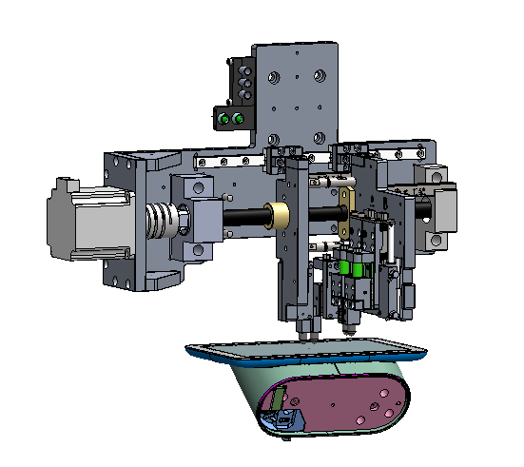
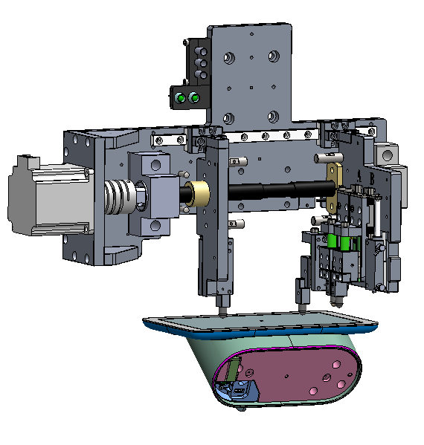
Bilateral movement
Cylinder up
Cylinder up
L min
L max
Note（Increase the pen distance description）:
1、6mm fabric and copper/brass finger ；L min=10mm，L max=75mm
2、7mm rubber and copper/brass finger ；L min=12mm，L max=75mm
3、9mm rubber and copper/brass finger ；L min=13.5mm，L max=75mm
4、12mm copper/brass finger ；L min=15mm，L max=75mm
5、Theoretical screen stroke speed is 0-30mm/s

Slide 11
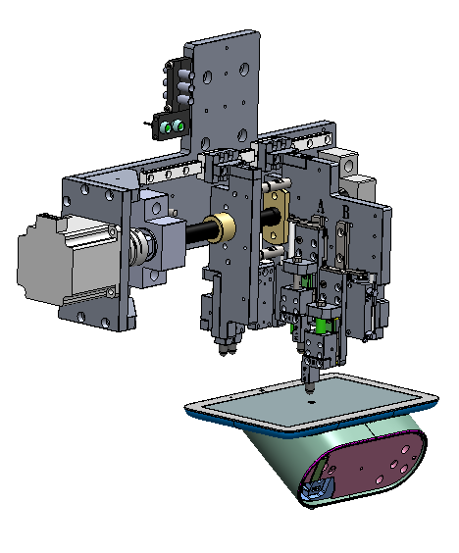
Single pen head line
Cylinder up
Cylinder down

Slide 12
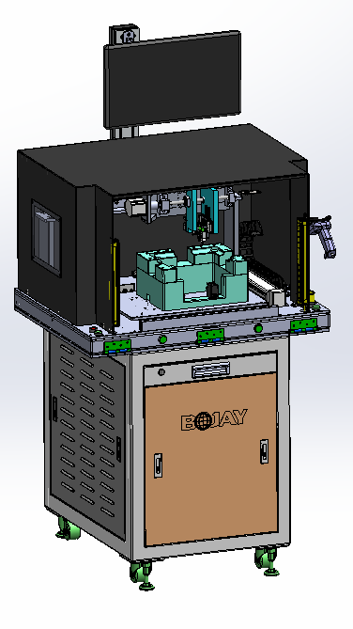
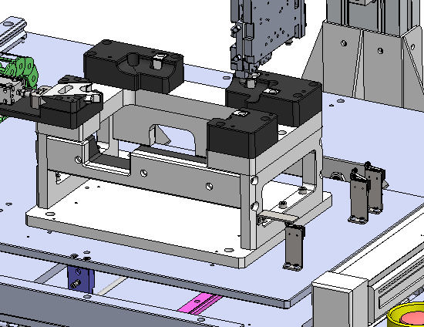
Switch E71、Ethel and Lucy
Ethel switch
Lucy switch
E71 switch
E71 holder module
Note:
1、When switching between Ethel and Lucy, needto change the Holder module
2、To quickly and easily switch between the Holder modules, use manual insertion USB and DC cable.
3、Need 3 SW and API configuration, one for Lucy ，one for Ethel and one for E71 separately.
4、Lucy’s SW and API must use with Lucy Holder, and Ethel’s SW and API must use with Ethel Holder. So need to change holder and SW at the same time and can’t make mistake. If make mistake, it is risky to damage DUT and fixtures

Slide 13
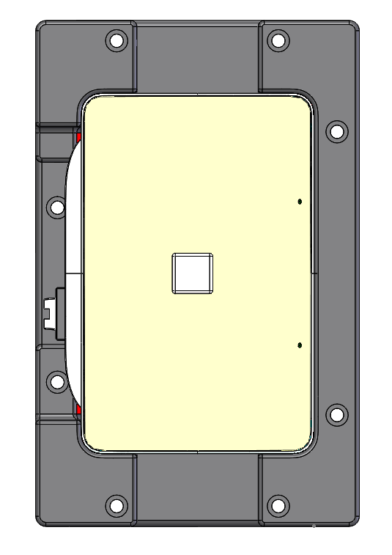
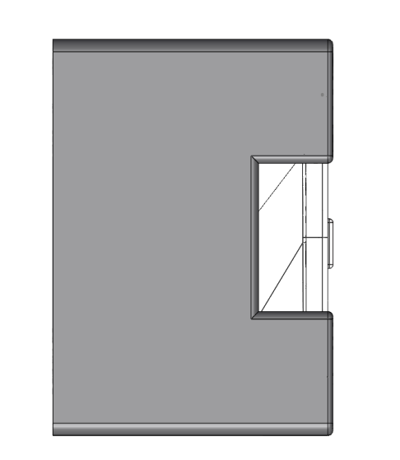
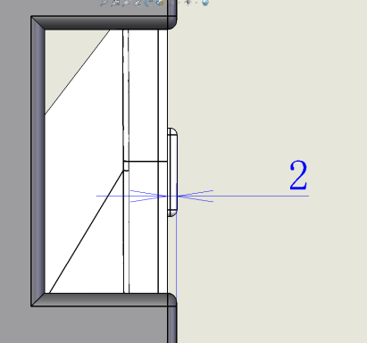
Calibration principle
1. Position calibration
O (0,0,0)
Y
X
TX1
TY1
TY2
TZ
A(X,Y)
A(Z)
TX2
1. Get the coordinate of TX1，TX2， TY1， TY2, TZ. (the position to touch the side of the calibration block
2. Calculate the coordinate of the reference point A
3. Calculate the coordinate of the 3 points’. For instance, point A should be (X=（TX1+TX2）/2, Y=（TY1+TY2）/2, Z=TZ+2mm)
Note: 1000, 10000 value are given by product team.

Slide 14
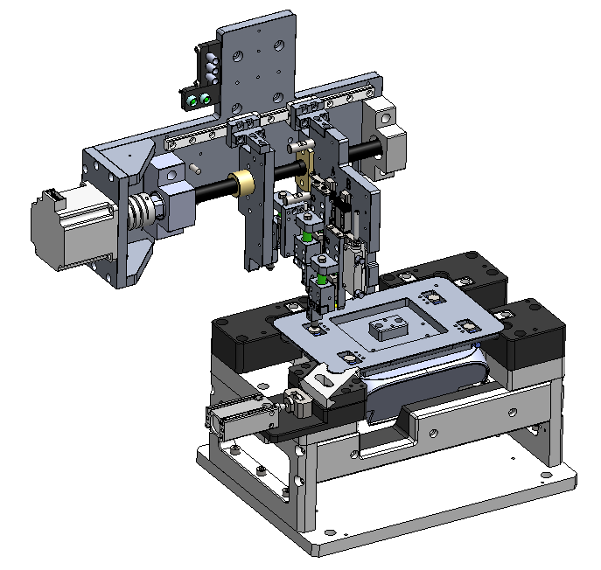
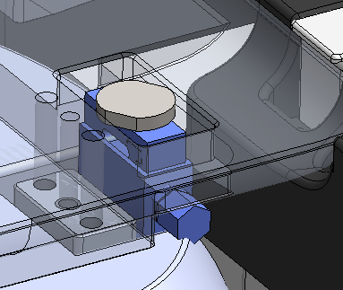
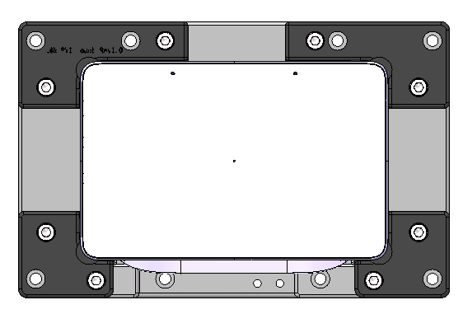
Pressure test
1. Control the capacitance pressure, contact with the pressure sensor tooling, read the pressure value
Pressure Sensor tooling
Holder
1
2
2. Use the same down stroke to press down the 1, 2, 3, and 4 positions of the DUT to compare the pressure values.
DUT
3
4

Slide 15
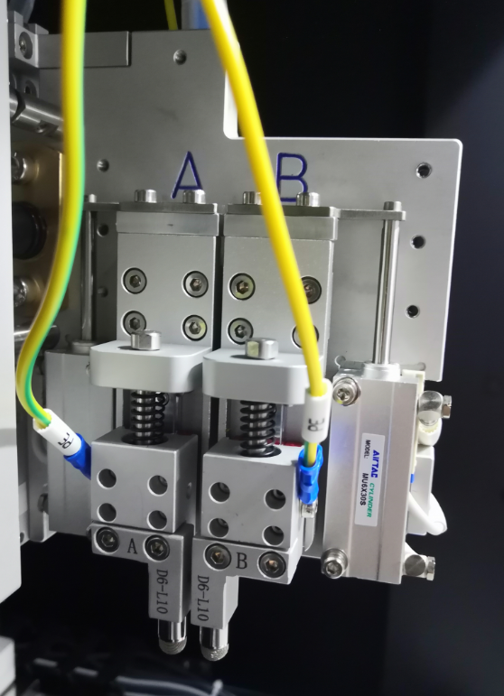
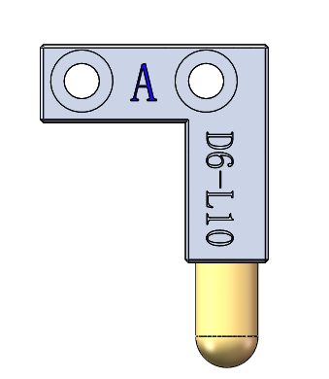
Description of pen tip change
A position
A：A fixed block
D6：Install 6mm diameter capacitance pen/copper head
L10：The distance between the two condenser pens is 10mm
A fixed block
1.When the pen heads of different specifications are replaced, the fixed block of A shall be installed in the position of A。B, C and D are the same as A。
2. Pay attention to the press stroke when replacing copper head to prevent damage to DUT

Slide 16
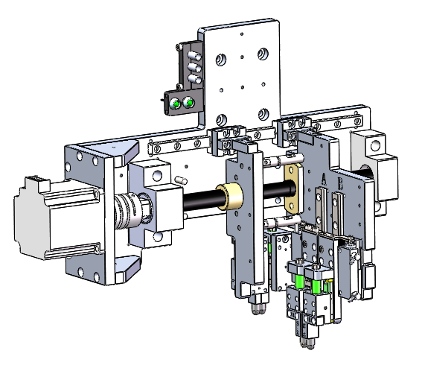
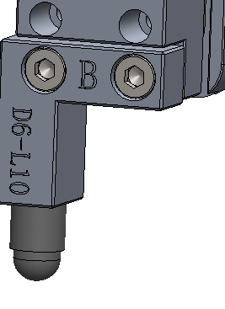
Capacitance pen switch
Loosen the screw to replace different capacitor pen modules

Slide 17
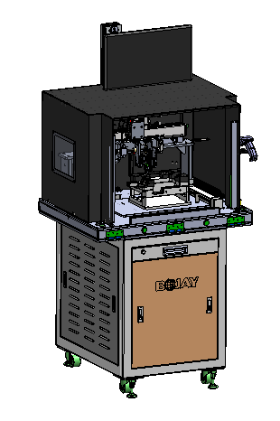
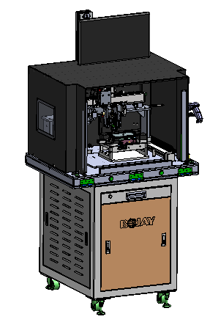
Operation process
Step1.：Artificial plug wire and
Loading DUT
Step2：Start
Step3： Testing
Step4： Test completed

Slide 18
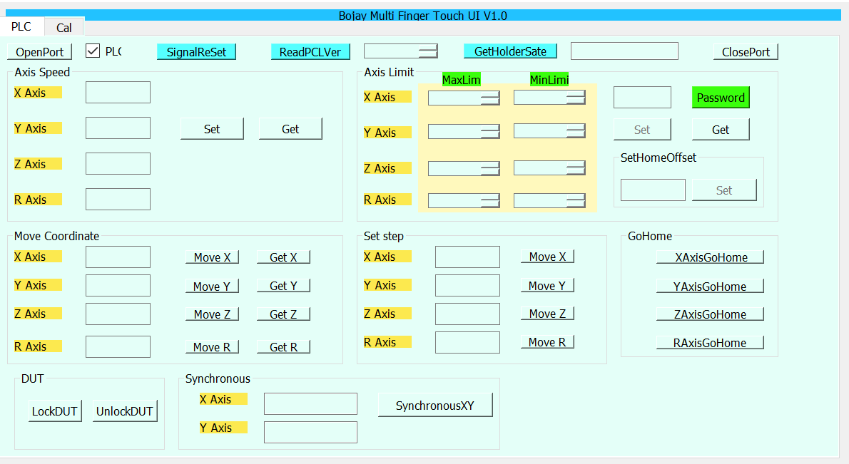
Software Operation UI
Bojay Multi Finger Touch UI V1.0

Slide 19
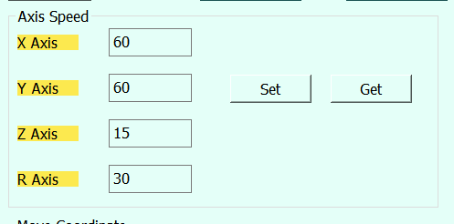
Operation four axis
1. Click “Open Port” to open serial port;
2.Click “SignalReset” to reset fixture;
3.Click “ReadPLCVer” to get Software version;
4.Click “GetHolderState” to get holder model;
5.Click “ClosePort” to close serial port
Axis speed setting and getting
Click “Get” to get axis speed,then axis speed displays in the text box ;
Input X/Y/Z/R speed to the text box,then Click “Set” to set axis speed ;

Slide 20
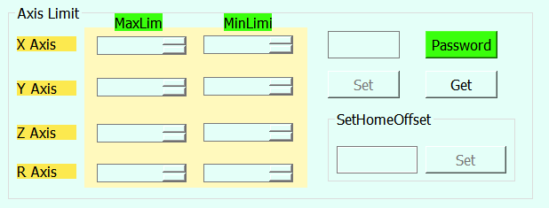
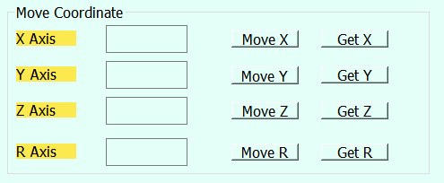
Operation four axis
Four axis Limit setting and getting
Click “Get” button of Axis Limit to get X/Y/Z/R Axis minimum
and maximun,then limit value show in the text box;
Enter the “Bojay” to the text box of password,then input limit
value and click “Set” button to set axis limit value.
note: A safe axis limit has been set for the fixture
Four axis absolute movement
Input the movement value to the X/Y/Z/R text box , then click
“Move X/Y/Z/R” to move the axis to the appropriate position;
click“Get X/Y/Z/R” to get current position of axis ;
note:with the tray inside,the axis can move absolutely

Slide 21
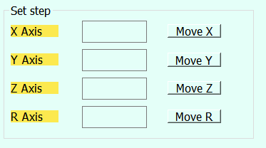
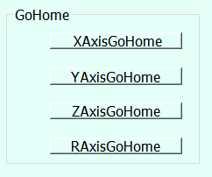
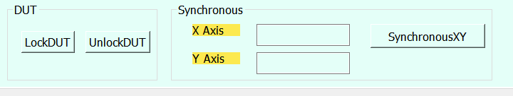
Operation four axis
Four axis relative movement
Input the movement relative value to the X/Y/Z/R text box ,
then click“Move X/Y/Z/R” to move the axis to the current
position ;
Four axis back to the origin
Click“X/Y/Z/RAxisGoHome” to
move the axis to the origin;
Click “LockDut” button to lock dut;
Click “UnLockDut”button to unlock dut;
Click “SynchronousXY” to move the XY axis in sync.

Slide 22
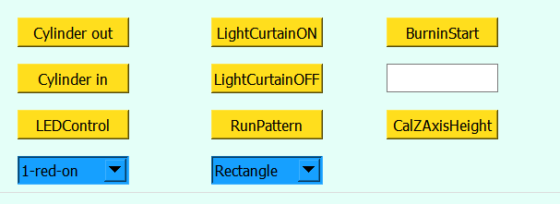
Operation of fixture
1. Click “Cylinder out” button to make tray out;
2. Click “Cylinder in” button to make tray in;
3.Select the led,click “LEDControl” button to make led off or on;
4.Click “LightCurtainON” or “LightCurtainOFF” button to make curtain on or off ;
5.Select “Rectangle”,click “RunPattern” button to move axis according the rectangle;
6.Click “BurningStart” button to start burning;
7.Click ”CalZAxisHeight”button to calibration ZAxis height.

Slide 23
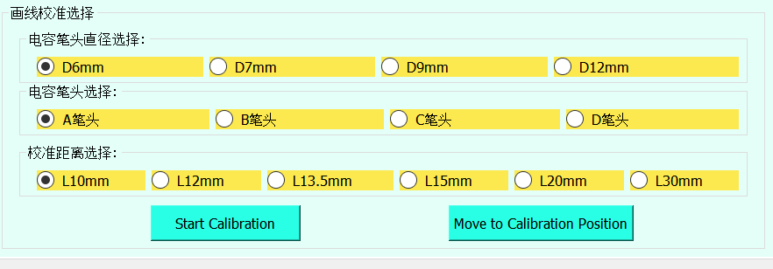
Calibration
Step1:Select capacitance pen\fixed block\calibration distance to calibration according to your request,for example:
A：A fixed block
D6：Install 6mm diameter capacitance pen/copper head
L10：The distance between the two condenser pens is 10mm

Slide 24
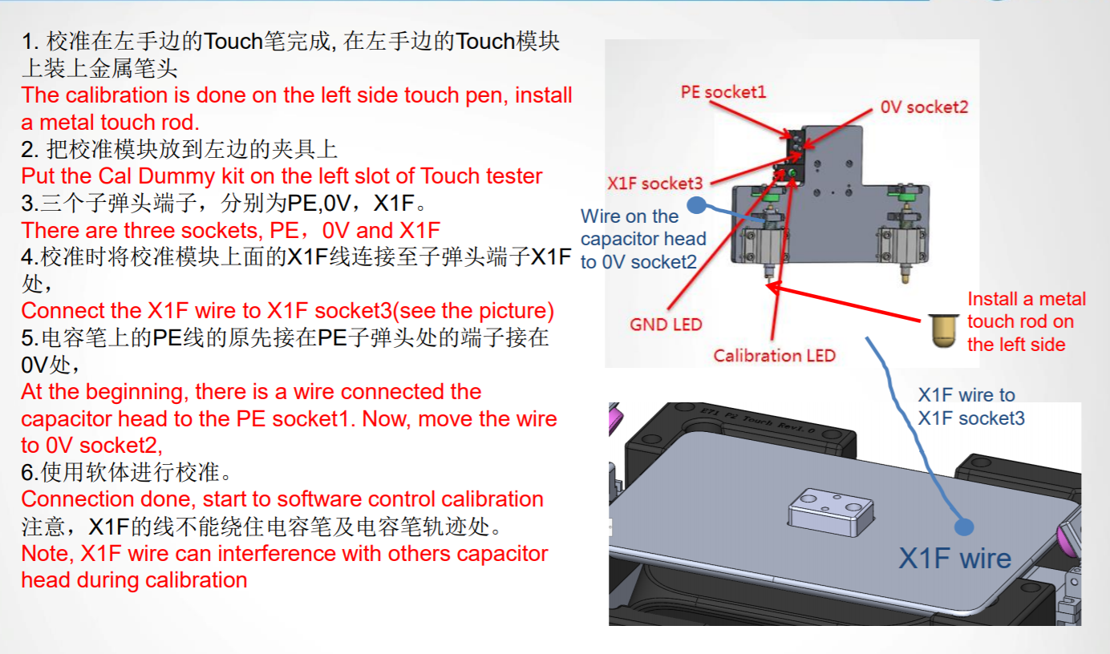
Calibration
Step2:Place the calibration tool inside the fixture as shown below,click “Start Calibration” button to
calibration.

Slide 25
Calibration
Step3:Click “Move to Calibration Position” button to move axis to calibration.

Slide 26

End
Thank you

